Slide 1
SC2001 Project 1: Integration of Merge Sort & Insertion Sort
Kish Choy, Hendy, Linghin

Slide 2
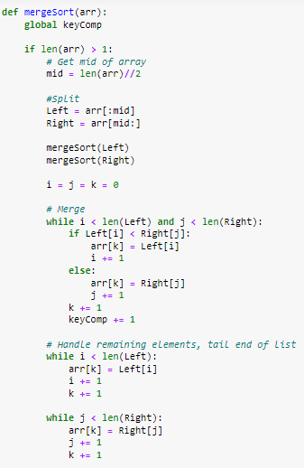
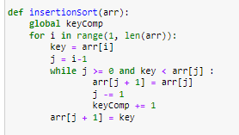
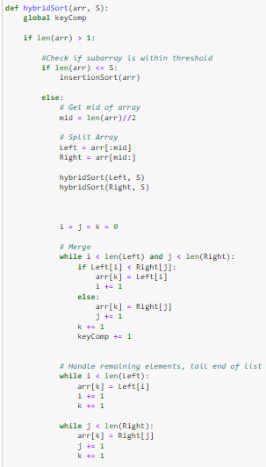
Algorithm implementation

Slide 3

b) Generate input data

Slide 4
c) Analyze time complexity
Parameters | Merge Sort | Insertion Sort | Hybrid Sort
Worst Case Complexity | O(N*log N) | O(N^2) | O( NS + N log (N/S) )
Average Case Complexity | O(N*log N) | O(N^2) | O( NS + N log (N/S) )
Best Case Complexity | O(N*log N) | O(N) | O( N + N*log (N/S) )
Efficiency | Comparatively Efficient. | Comparatively Inefficient. | Comparatively Efficient.
Notes:
N/S because there are only
Normal merge n arrays of one length
N/S arrays of S length
Therefore will only have Log N/S layers of recursion
NS + is the Insertion sort
1 time is S^2
Need to do N/S times therefore Total = (N/S) * S^2 = NS

Slide 5
c) Analyze time complexity
Parameters | Merge Sort | Insertion Sort | Hybrid Sort
Worst Case Complexity | O(N*log N) | O(N^2) | O(N^2)
Average Case Complexity | O(N*log N) | O(N^2) | O(N*log N)
Best Case Complexity | O(N*log N) | O(N) | O(N*log N)
Works well on | On huge dataset. | On small dataset. | On certain dataset size
Efficiency | Comparatively Efficient. | Comparatively Inefficient. | Comparatively Efficient.

Slide 6
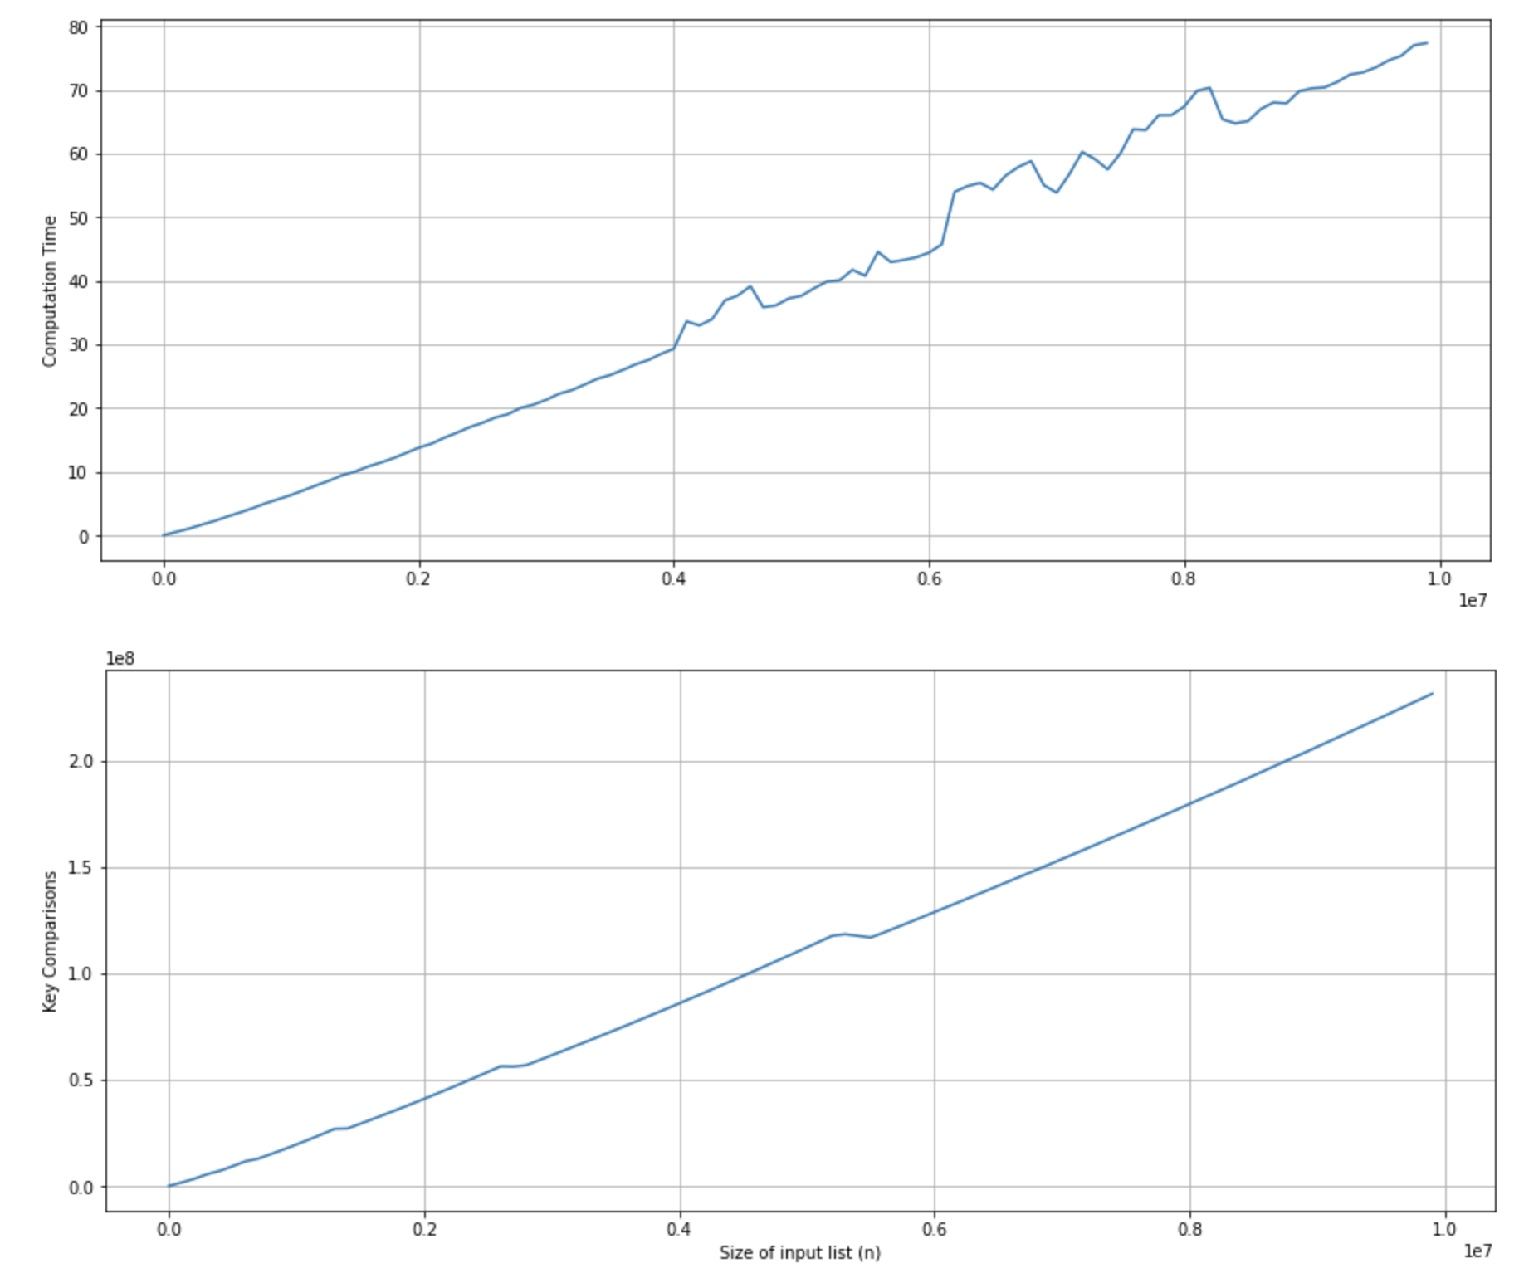
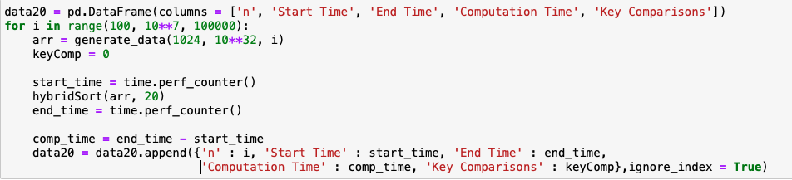
c i)
Fixed S, Varying n
S = 20, 100 ≤ n ≤ 10 000 000 (Step=100000)
As n increases, the computation time and number of key comparisons also increases
Time complexity of Insertion sort: O(nS)
(S^2) * (n/S) = nS
Time complexity of Merge Sort: O(nlg(n/S))

Slide 7
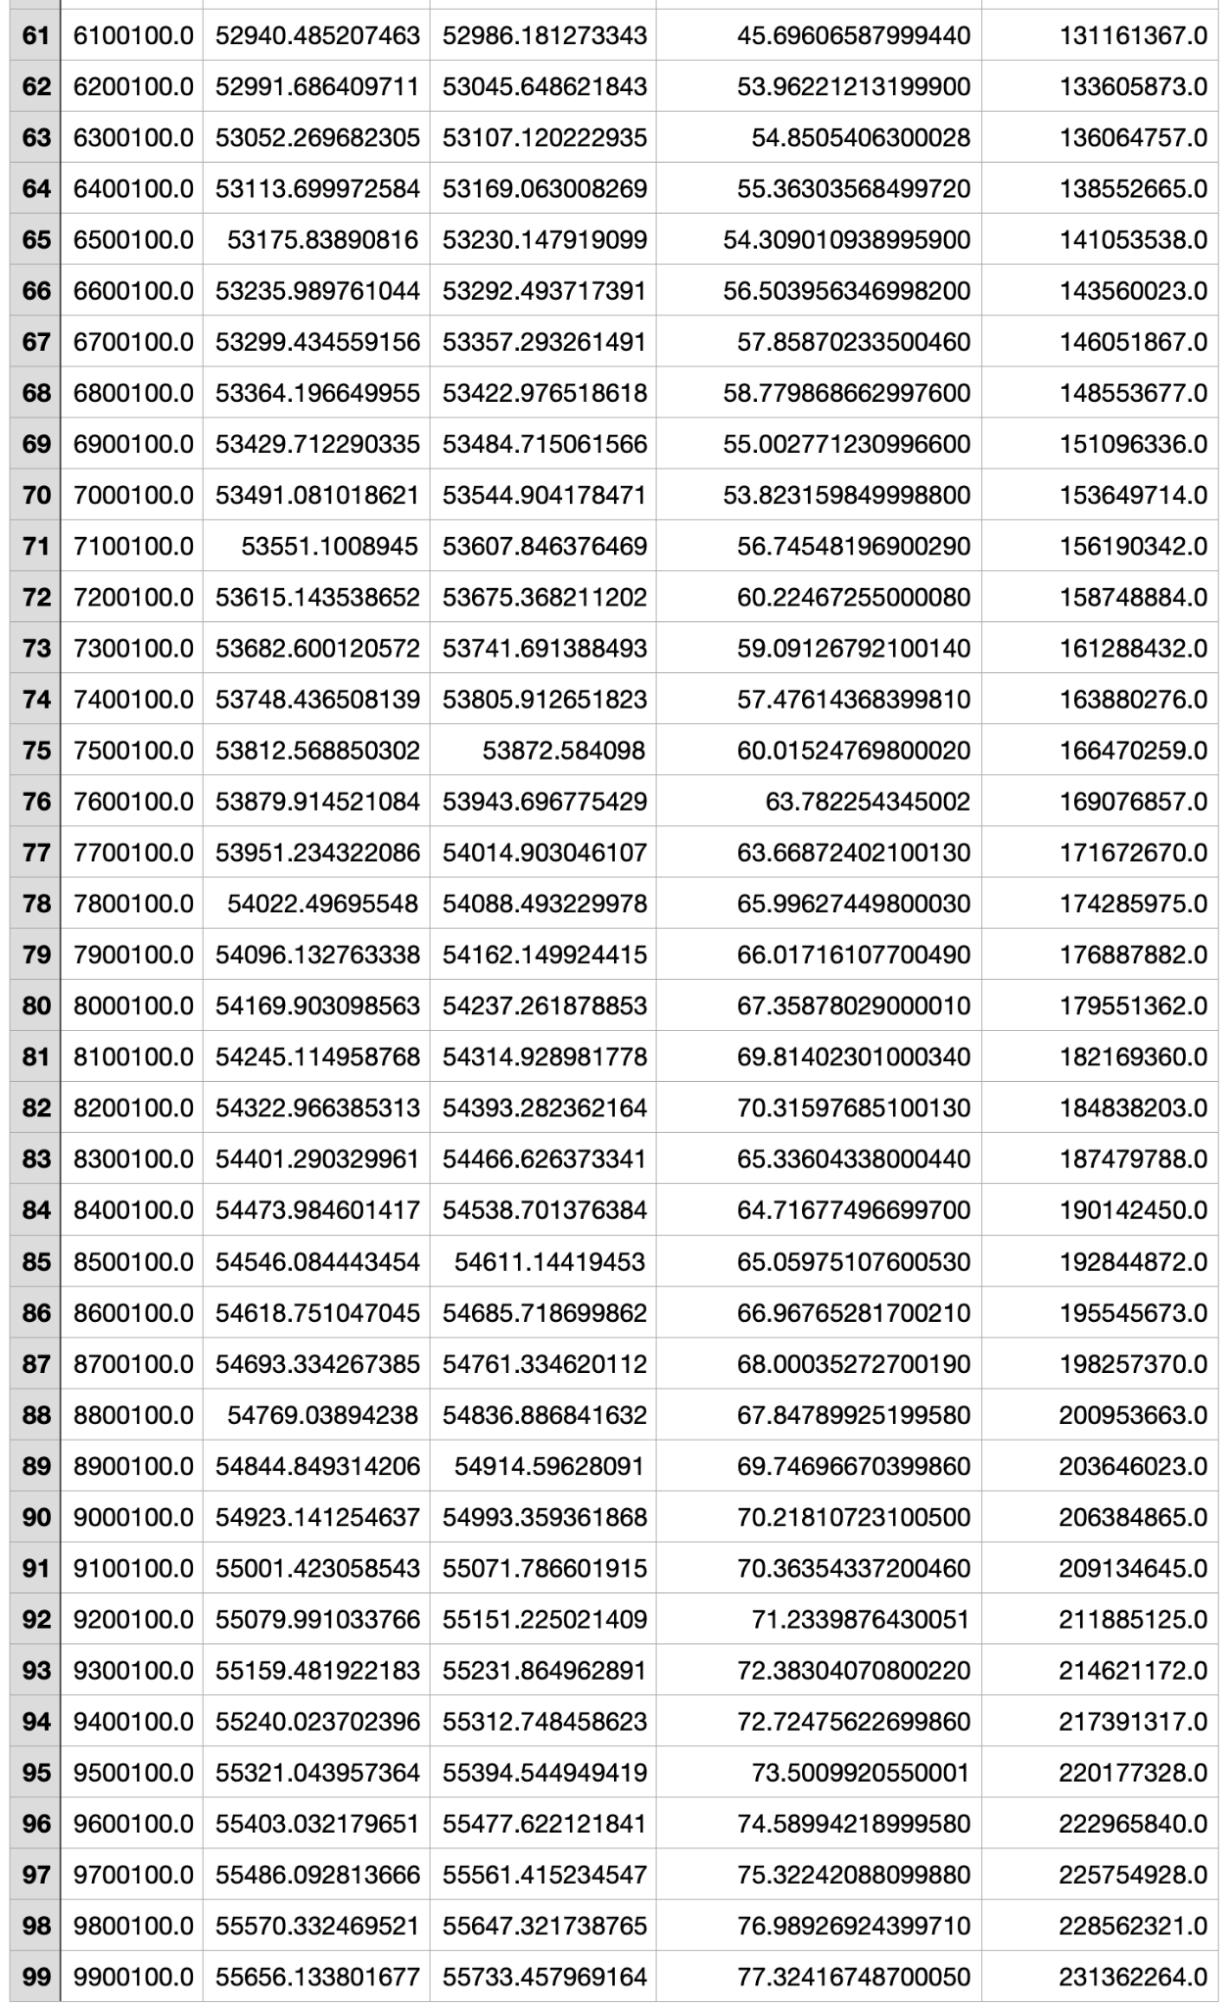
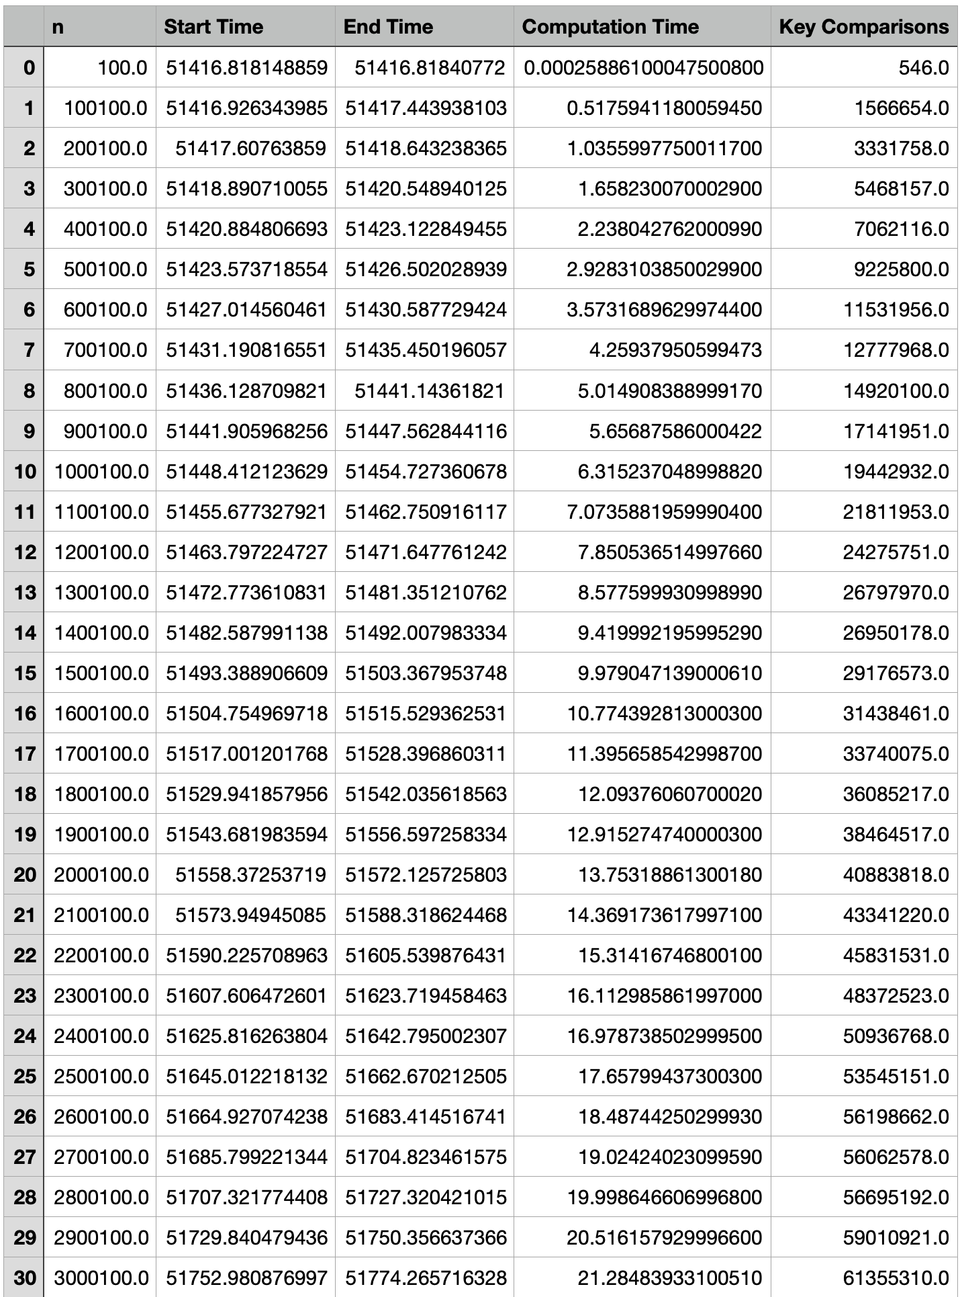
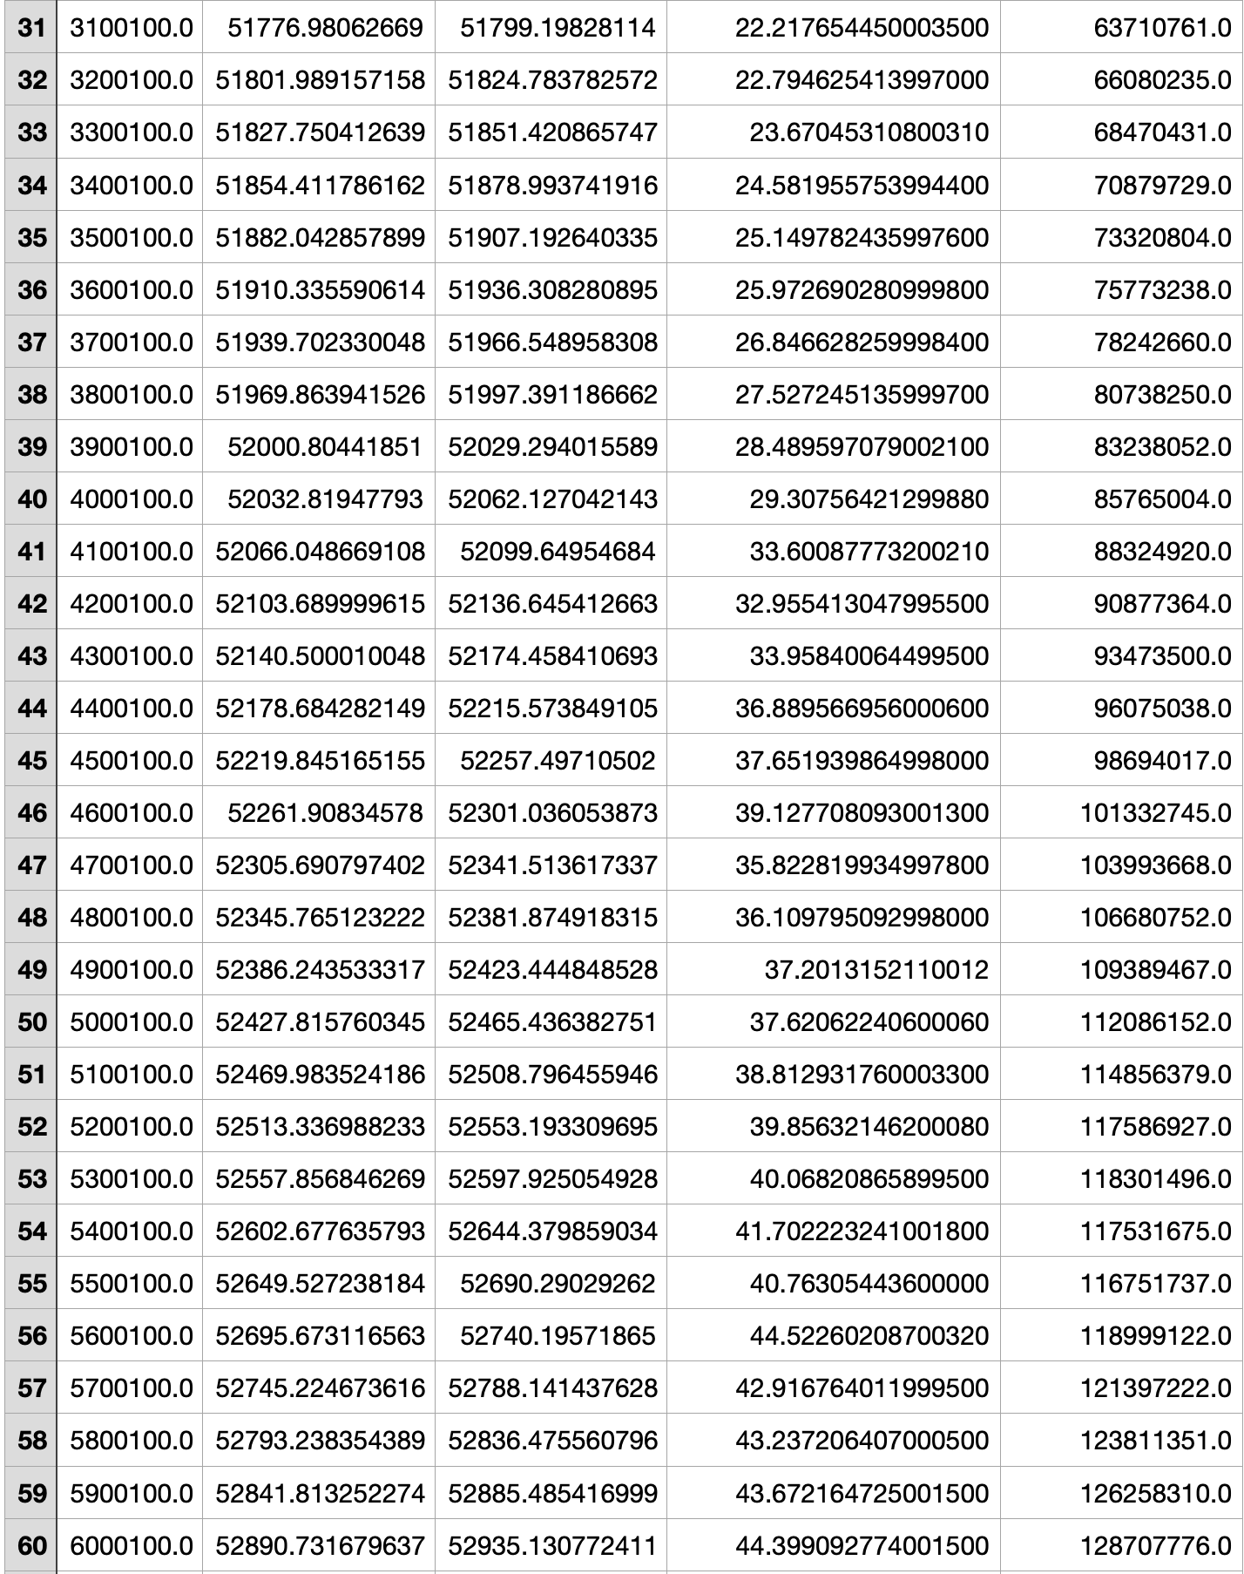
ci) Empirical Data

Slide 8
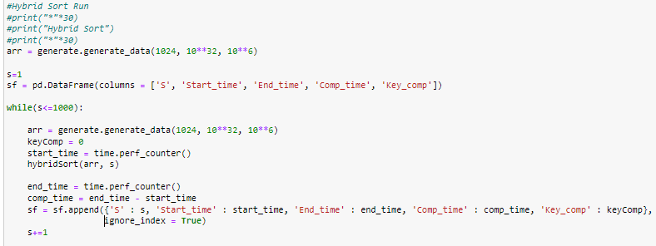
c ii)
Fixed n, Varying S
Taking a fixed n = 1000000 and loop from S 1 to 1000

Slide 9
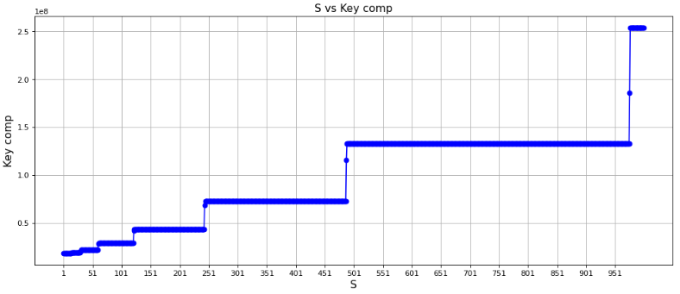
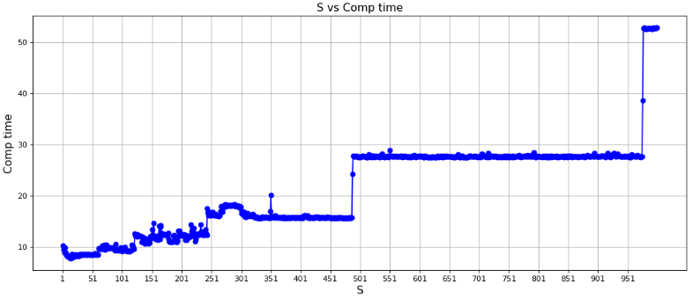
Fixed n, Varying S
Notes:
Mention about higher S the sorting system will resemble insertion sort which have complexity of O(N^2)

Slide 10
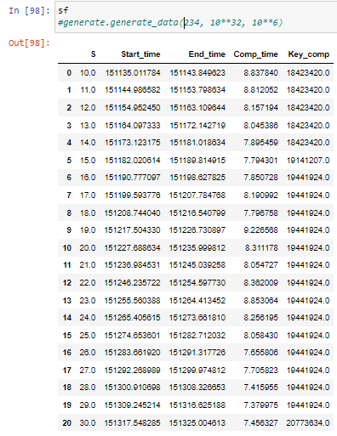
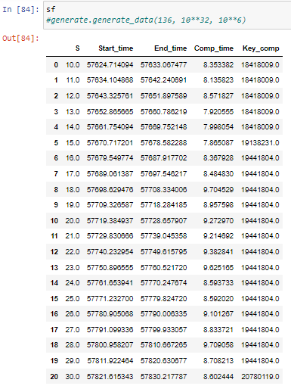
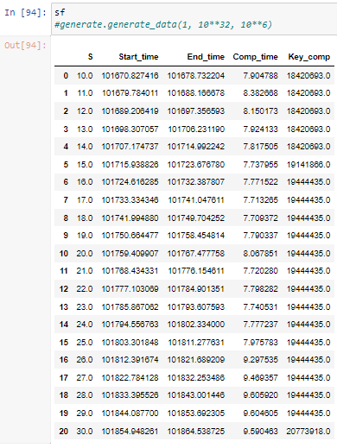
S optimal (Lowest computation time)

Slide 11
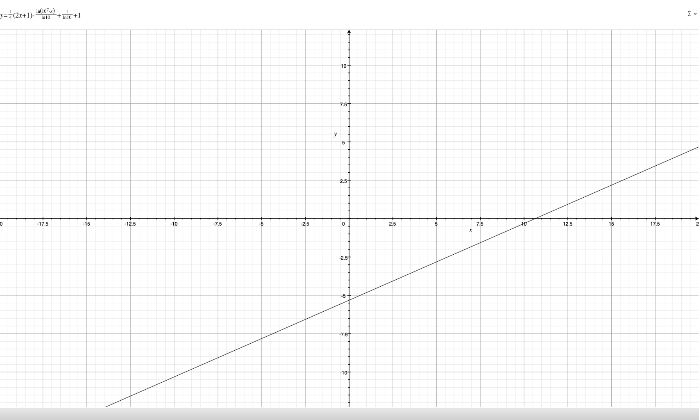
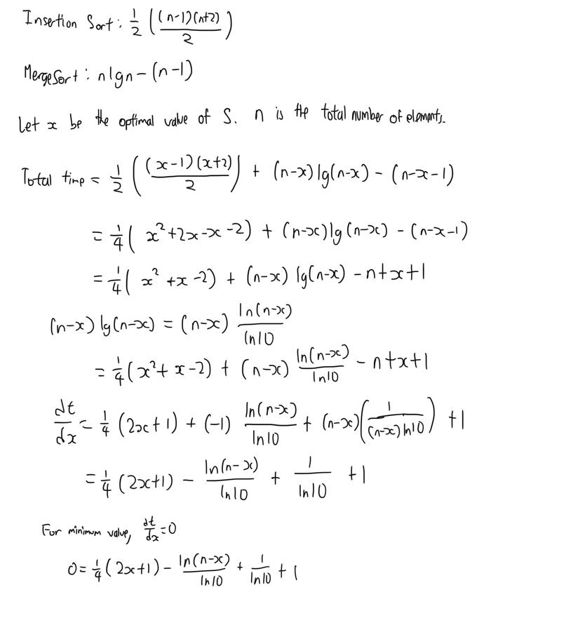
Finding Optimal Threshold S
c iii)

Slide 12
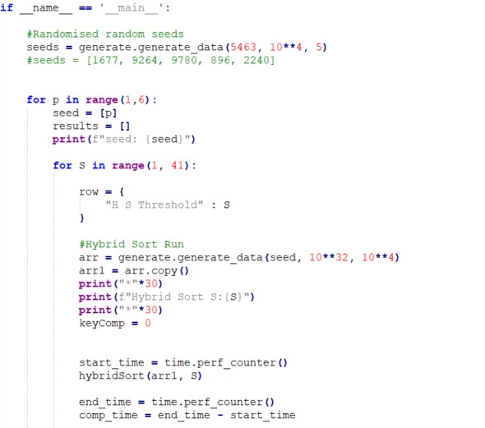
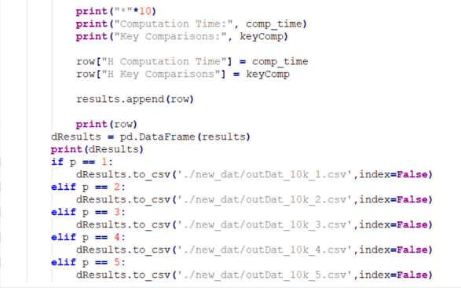
Compiled Empirical Stats
c iii)

Slide 13
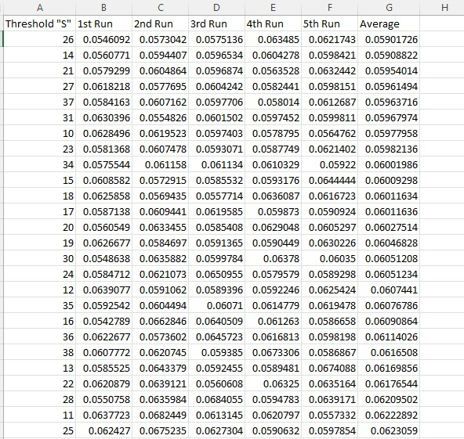
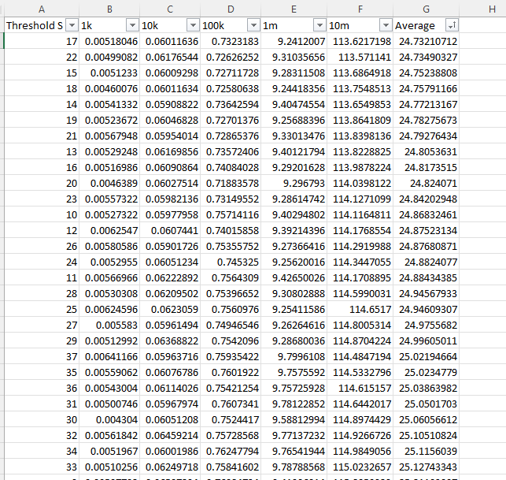
Compiled Empirical Stats
c iii)
10k Average Stats
Compiled Average Stats

Slide 14
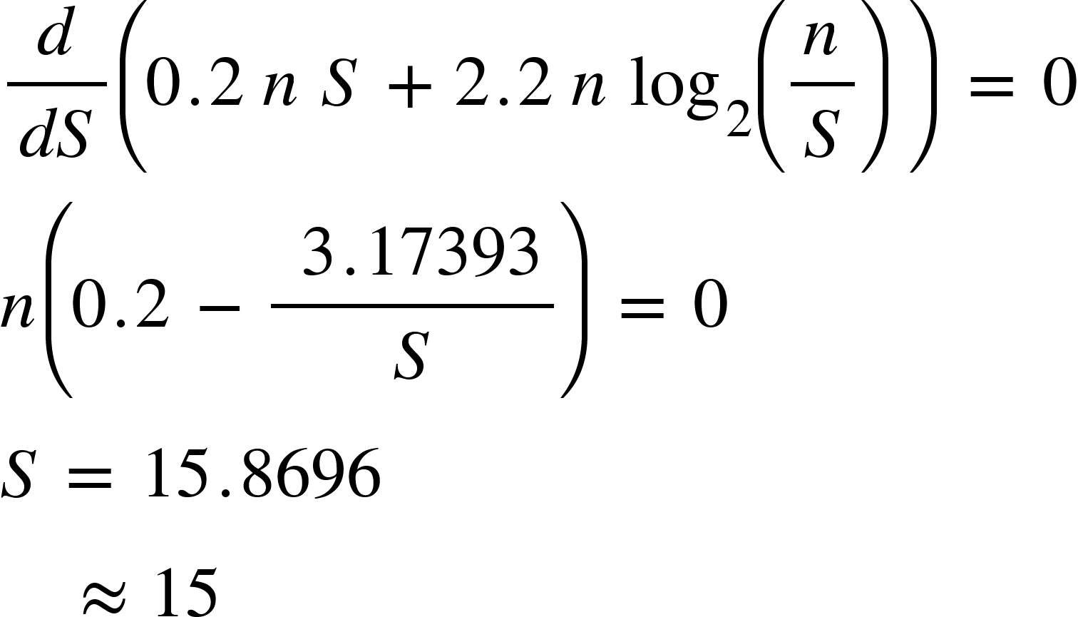
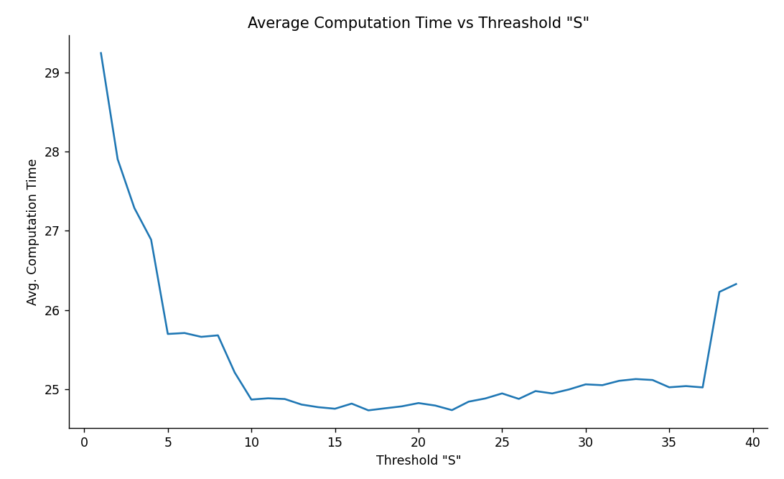
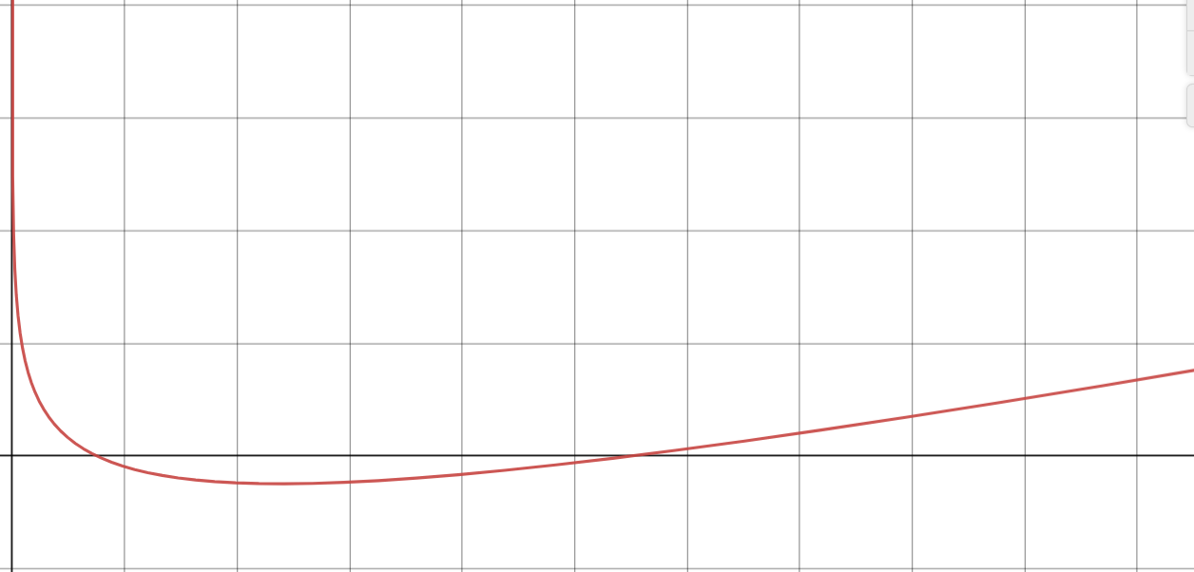
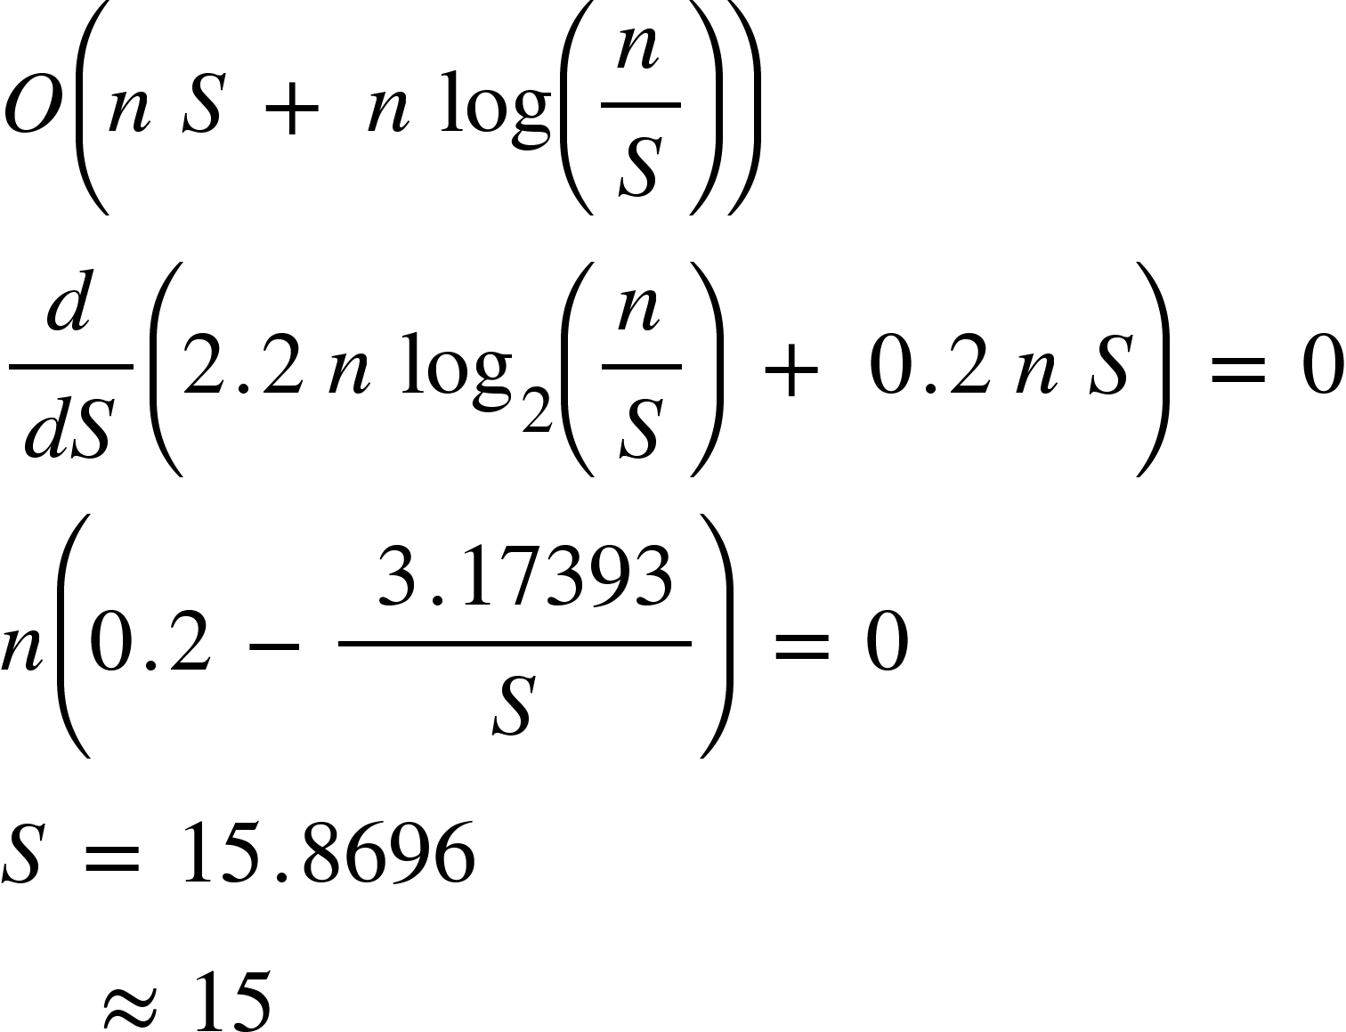
Compiled Empirical Stats
c iii)
Empirical
Theoretical
O( n S + n log (n/S) )

Slide 15



Compiled Empirical Stats
c iii)
O( NS + N log (N/S) )

Slide 16
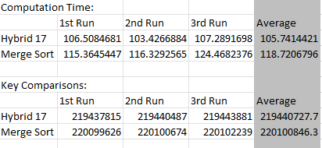
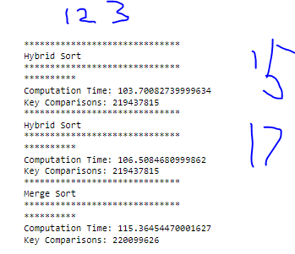
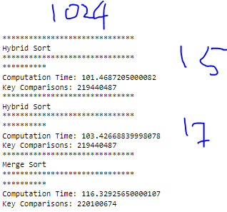
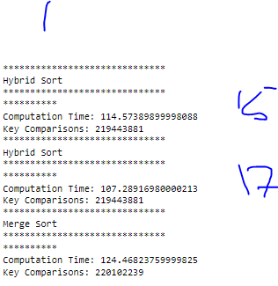
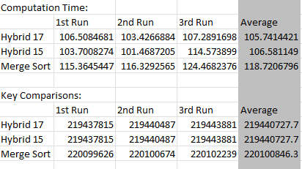
d) Compare with original Mergesort:
Compare its performance against the above hybrid algorithm in terms of the number of key comparisons and CPU times on the dataset with 10 million integers. You can use the optimal value of S obtained in (c) for this task.

Slide 17
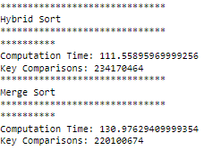

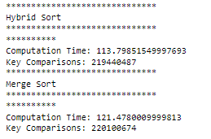
d) Compare with original Mergesort:
Compare its performance against the above hybrid algorithm in terms of the number of key comparisons and CPU times on the dataset with 10 million integers. You can use the optimal value of S obtained in (c) for this task.
117.682
S = 11
S = 15
S = 37
105.893
107.235
108.656

Slide 18
Thank you.

